Slide 1
Maze
Start
To get started click on ‘Play from Start’ in the Slide Show menu, then click the button above

Slide 2
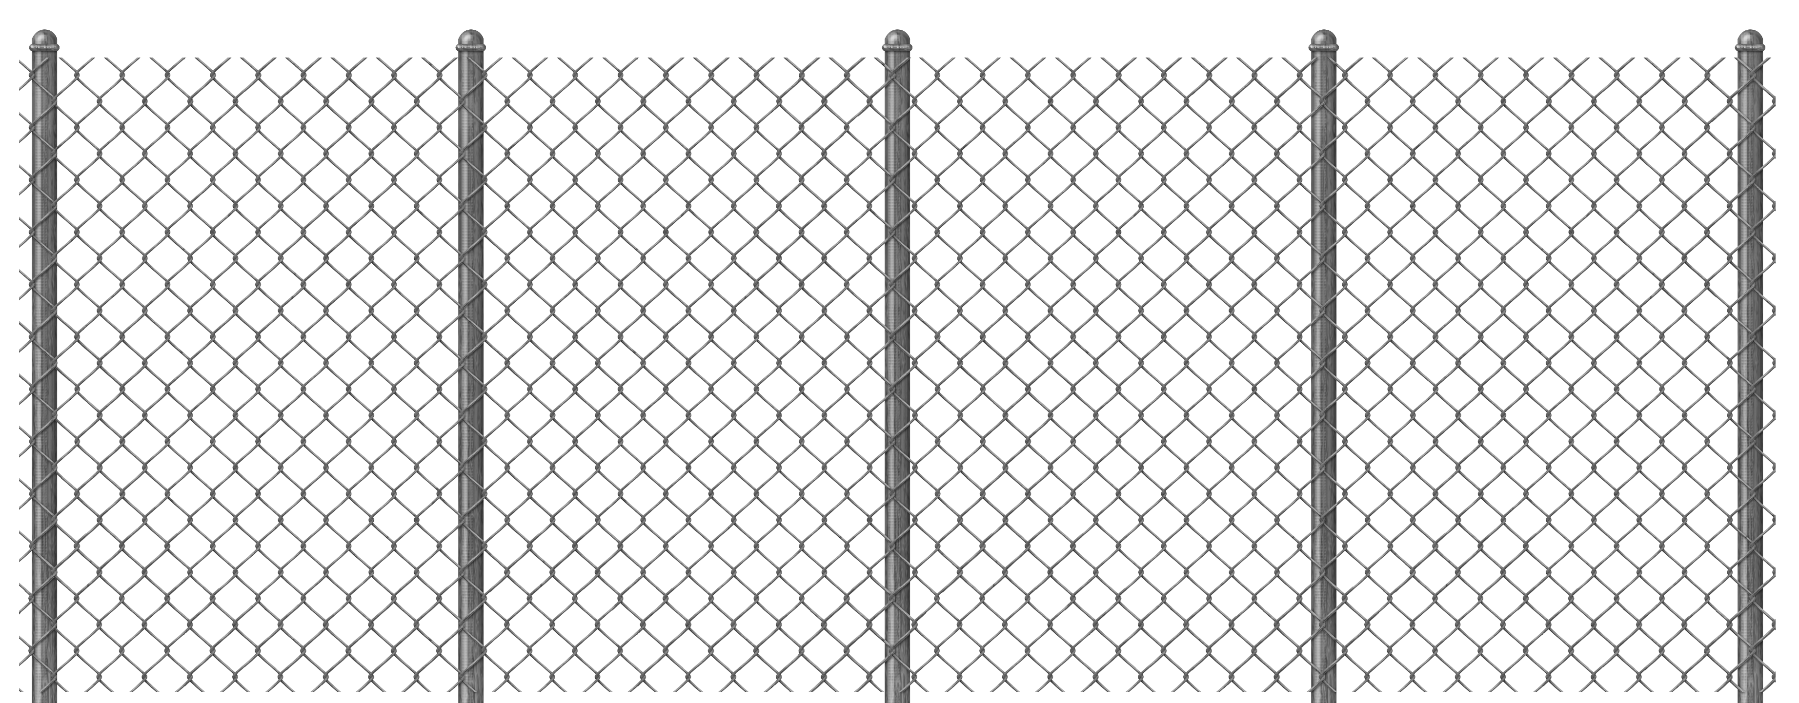
Get through the line

Slide 3
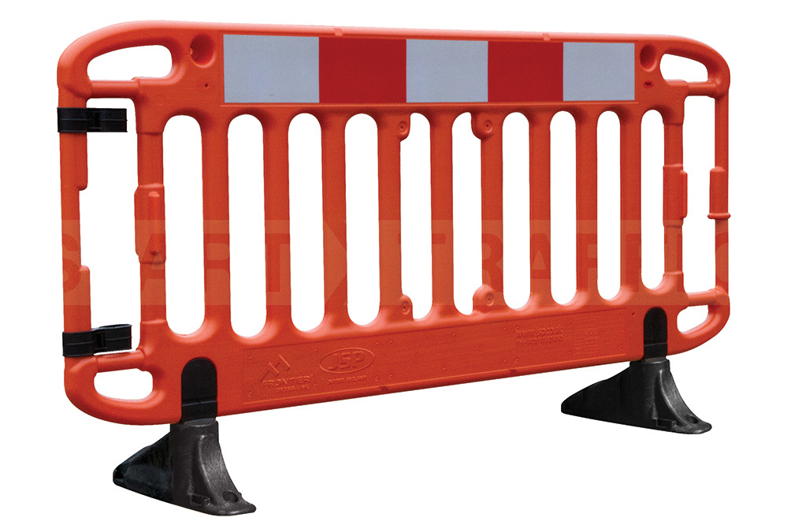
Sneak through the barriers

Slide 4
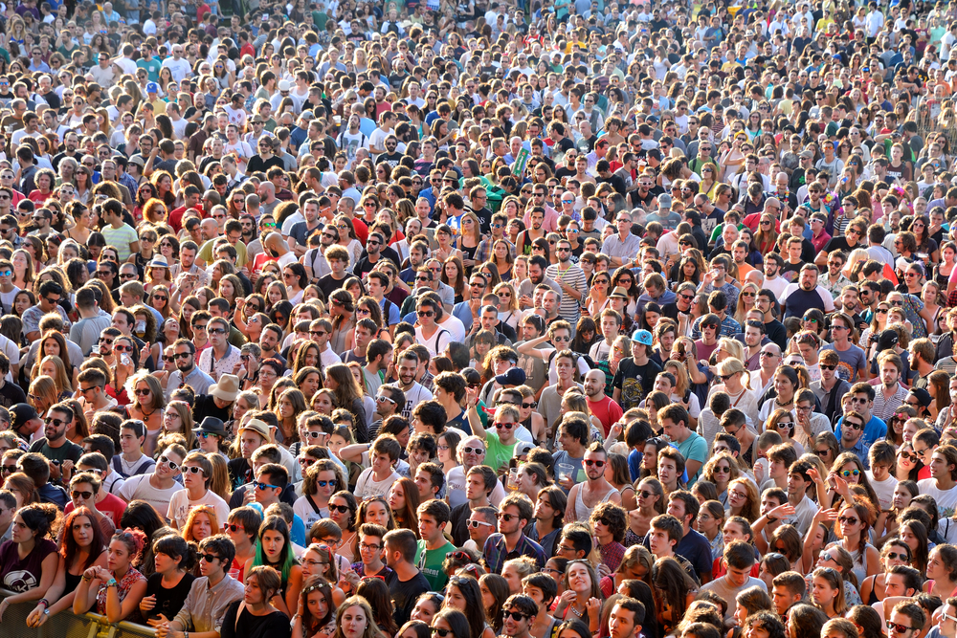
Get through the crowd

Slide 5
Park the boat :D

Slide 6

You won :D

Slide 7
You failed try again

